Slide 1

National Institute of Technology,Calicut.
Calicut-673601.

Slide 2
Computerisation of Faculty Advisor System
Submitted By:
Ponnam Sai Krishna | B150729CS
Amburi Gunasekhar | B150496CS
Karupally Bharath | B150429CS
Dowrla Ashok | B151041CS

Slide 3
INTRODUCTION
Computerisation of Faculty Advisor System is an interface between the students and FAs in an institute. It acts as a tool that reduces the heavy manual work of both FAs and students. This system ensures an easy communication between the Faculty Advisor and Students. All the information about the students is easily accessible to FA. Students find it easier to update the academic information at the start of every semester. The system ensures a login protected user interface with functions that are user specific.

Slide 4
TOOLS
Front-End: HTML,CSS
Back-end: SQL AND PHP
Web Server: APACHE
Database: PhpMyAdmin

Slide 5
Relational Schema
appointment_details | appointment_status | date | student_login_roll_number | fa_login_fa_id
Messages | read | student_login_roll_number | fa_login_fa_id | from_id
cid | course_name | sem | credits | fa_login_fa_id
sem | grade | attendance | course_name | cid | credits | student_login_roll_number
roll_number | password | details_filled | fa_fa_login_fa_id
username | password | name | email_id | mobile | designation

Slide 6
s1 | s2 | s3 | s4 | s5 | s6 | s7 | s8 | v1 | v2 | v3 | v4 | v5 | v6 | v7 | v8 | sturollnumber
fa_login_fa_id | name | forbatch | email_id | mobile | designation

Slide 7
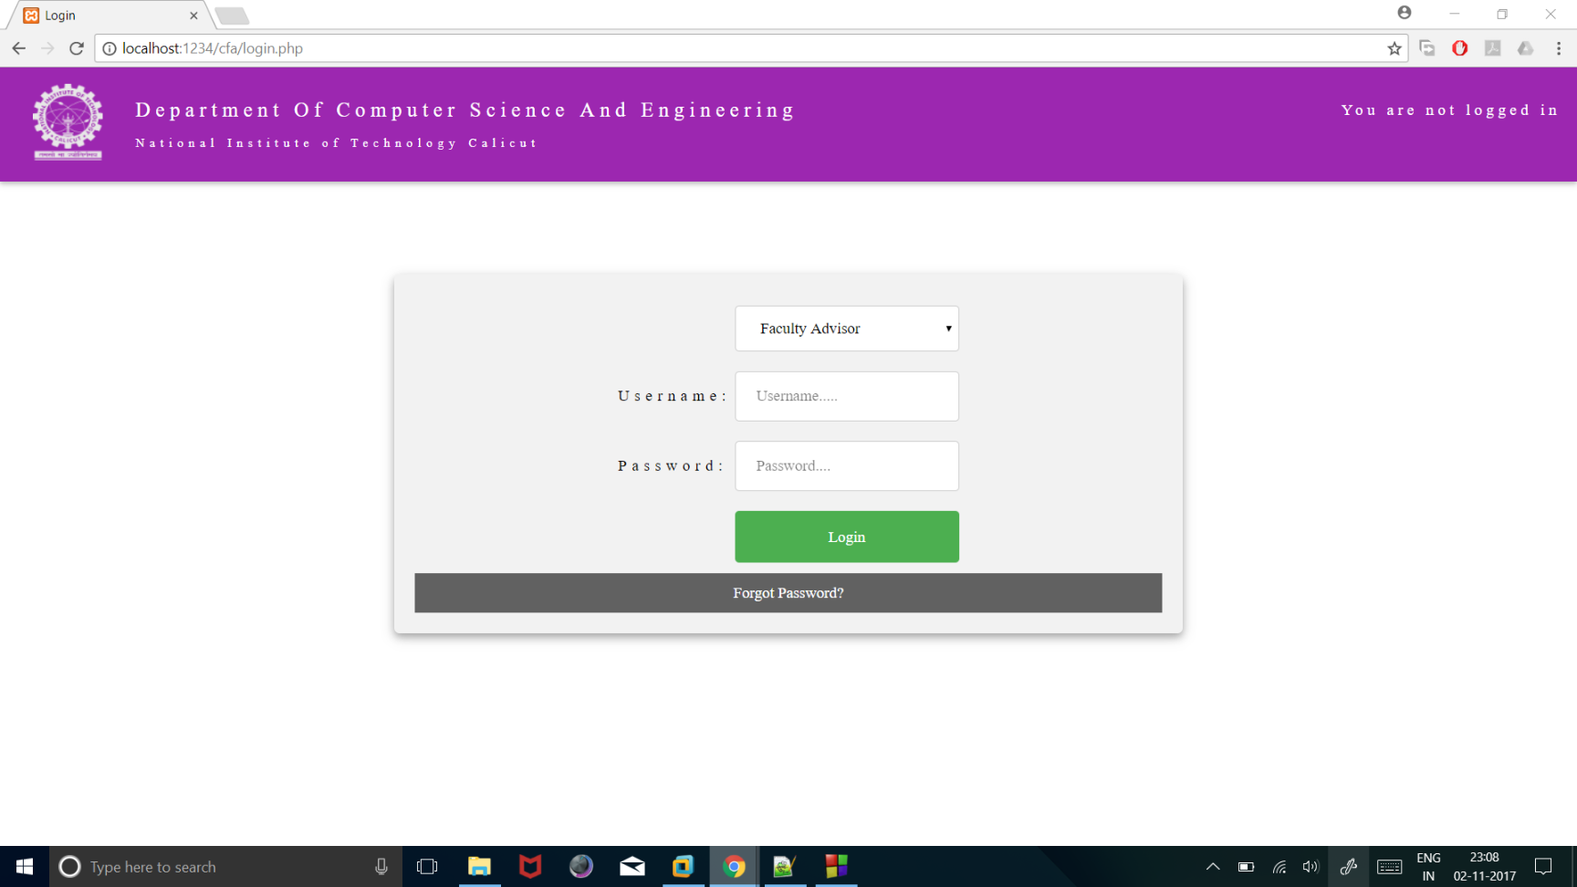
Login Page
Users login to the system with a admin generated username and password. The password can be updated later by the user.

Slide 8
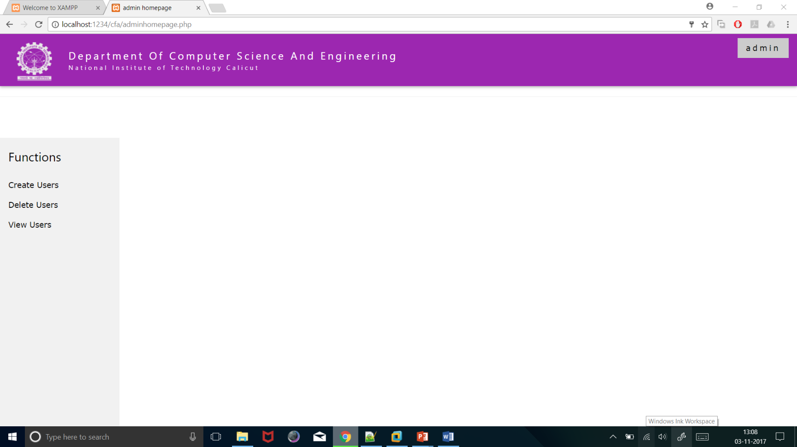
Admin Home Page
Admin creates,deletes and views users.

Slide 9
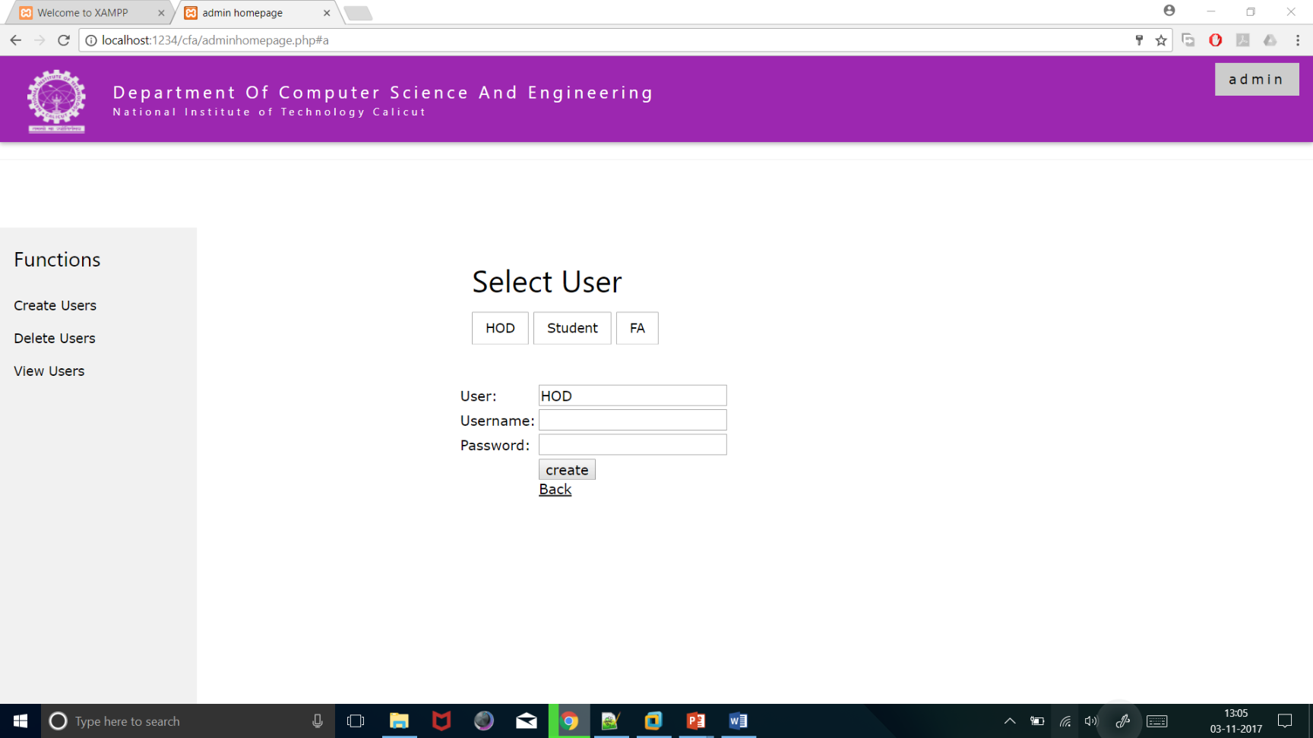
Create-user function
Admin creates unique usernames and passwords for the users. Admin also assigns FA to the student.

Slide 10
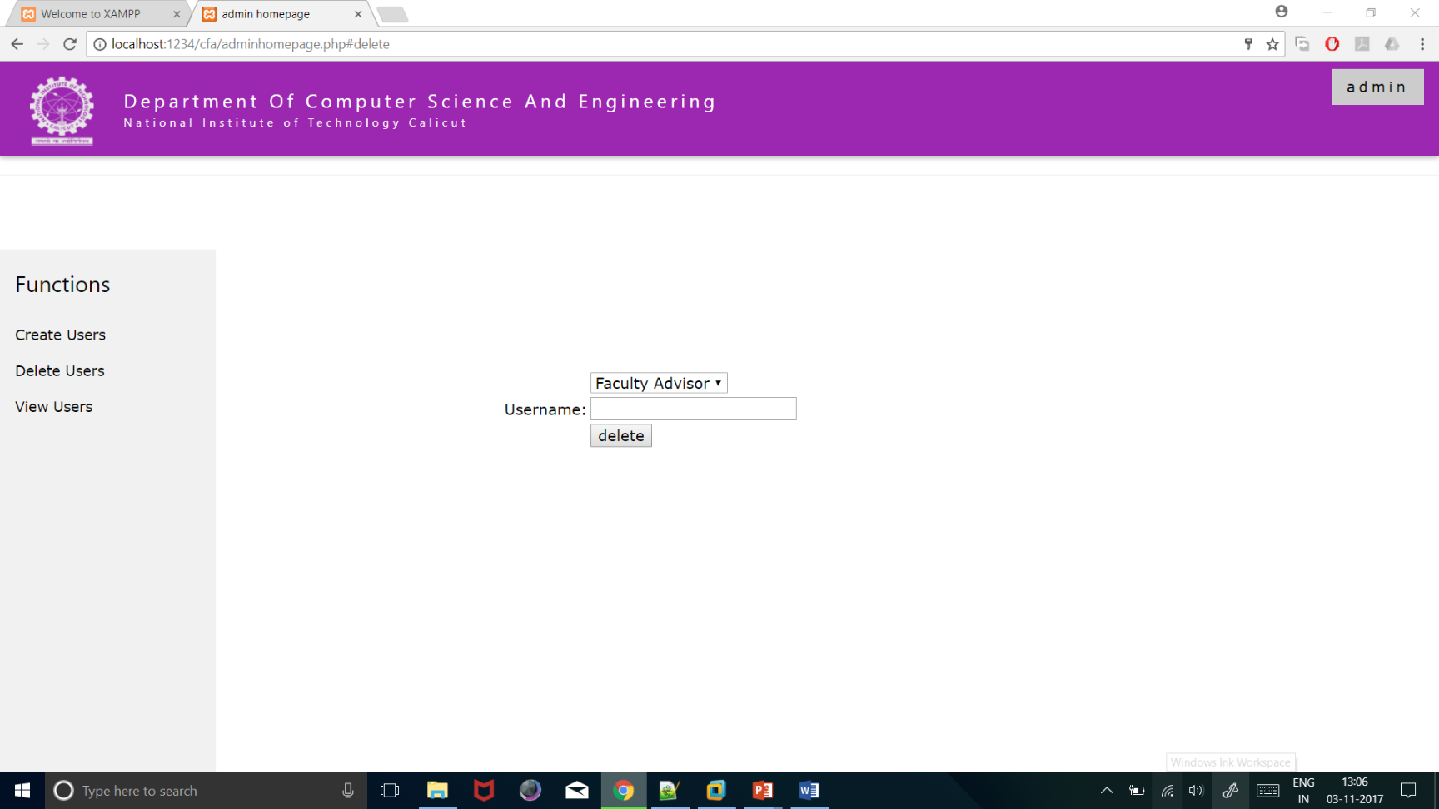
Delete-user function
Admin has the authority to delete user of any kind if he finds unauthorized user.

Slide 11
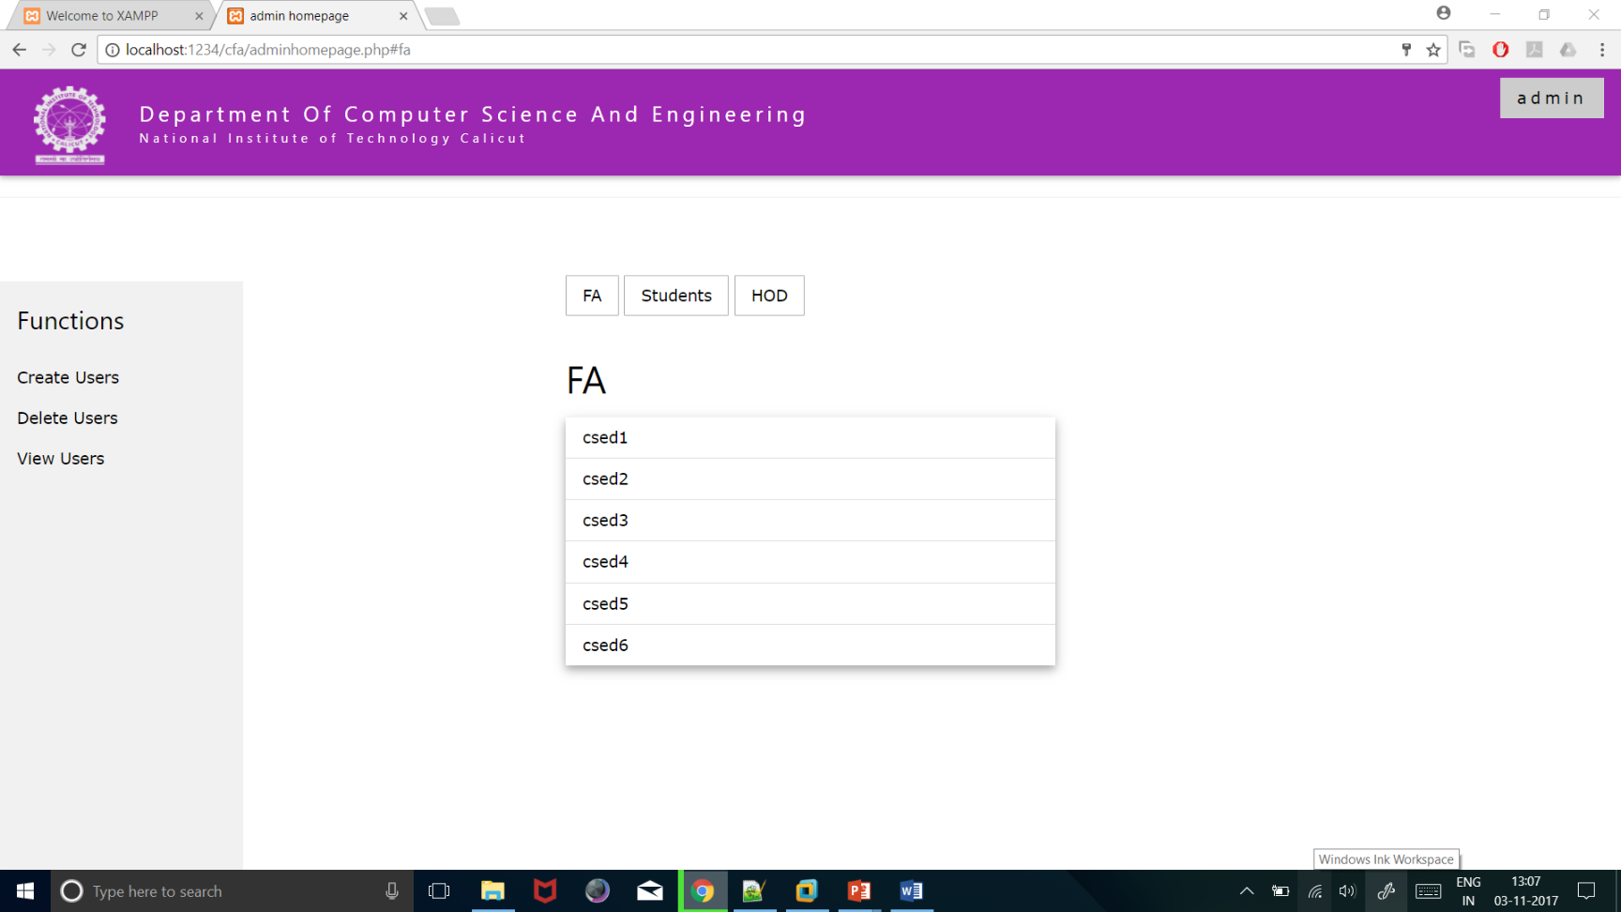
View-user function
Admin can view all the users.

Slide 12
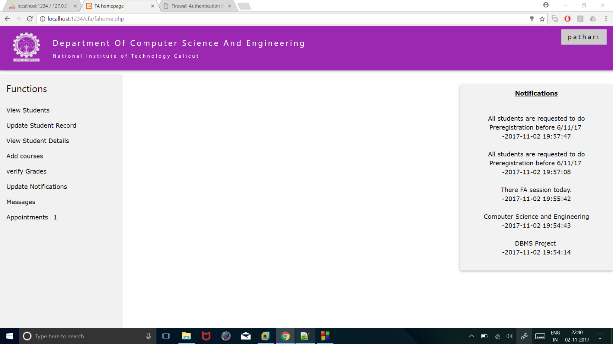
Faculty Advisor Homepage
FA can update profile,view student details, update student record and notifications. Process appointment requests, add and remove courses.All the functionalities are provided in menu driven manner in the sidebar.

Slide 13
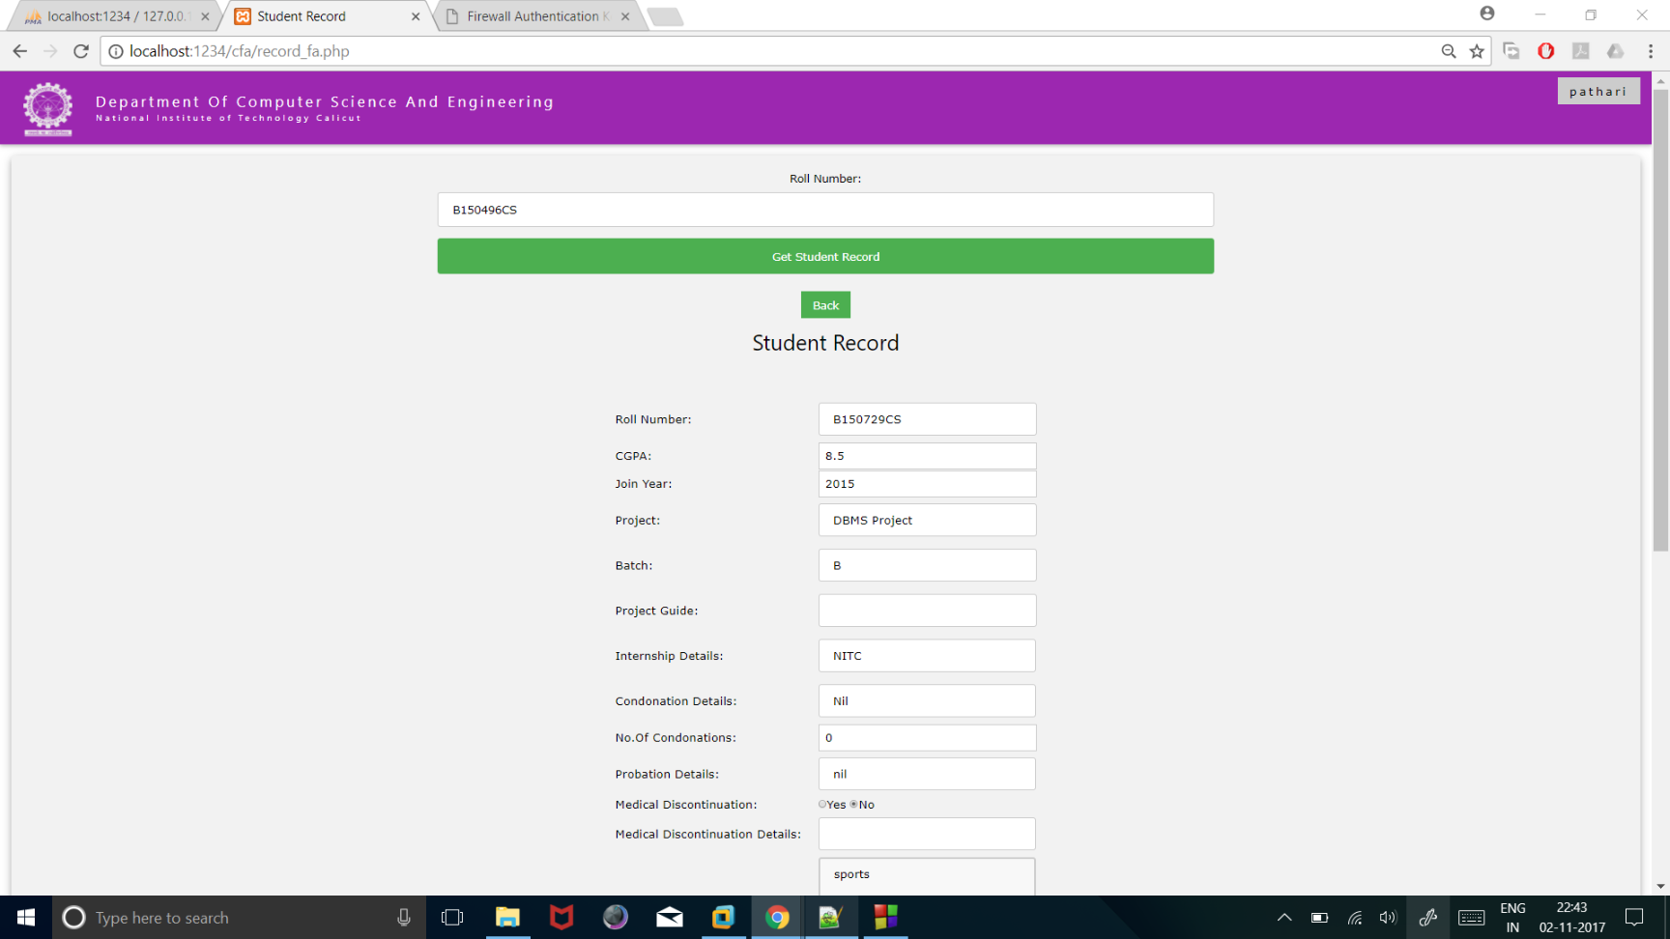
Update student record function
FA can update student information about intern details, disciplinary details and many others by giving the username of student as the input.

Slide 14
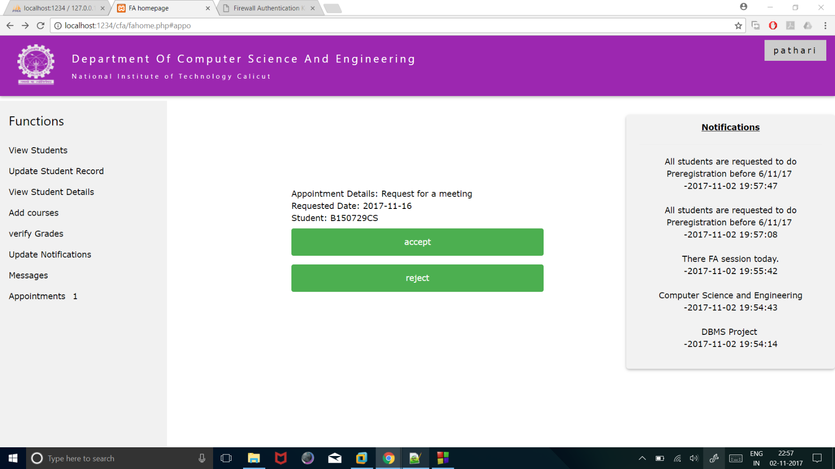
Appoinments
FA can view the details of appointment requested by the student and accept or reject according to his convenience. A badge in the sidebar shows the number of appointments that are not checked

Slide 15
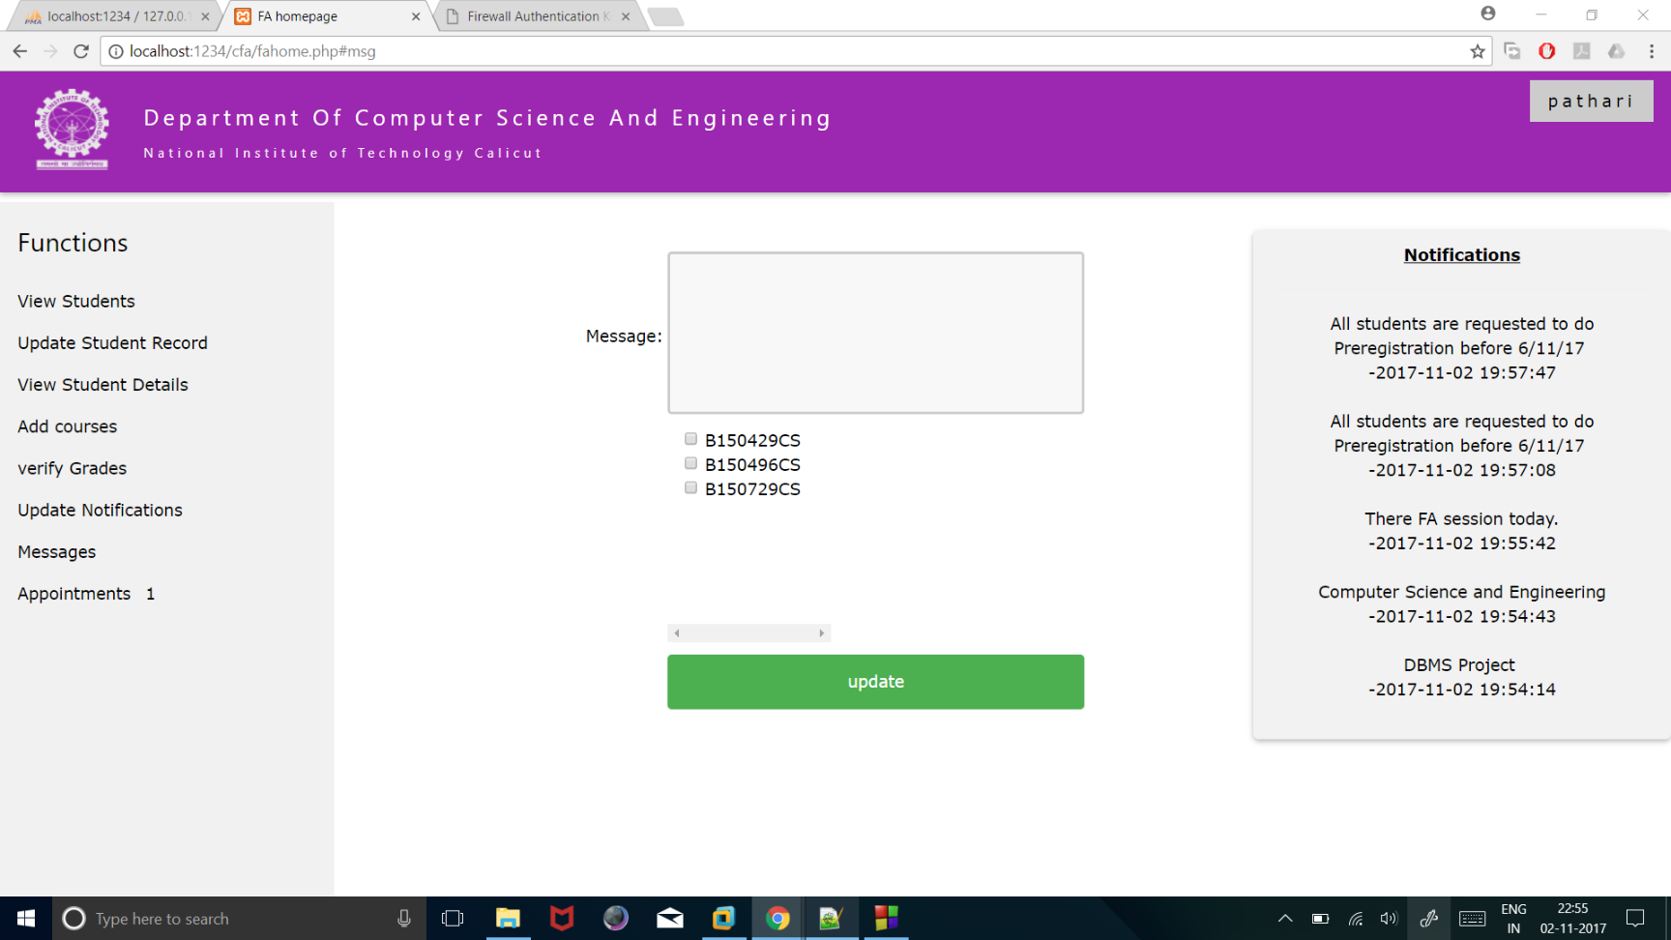
Messages
FA can send messages to one or many students at a time and can view messages he received from students.

Slide 16
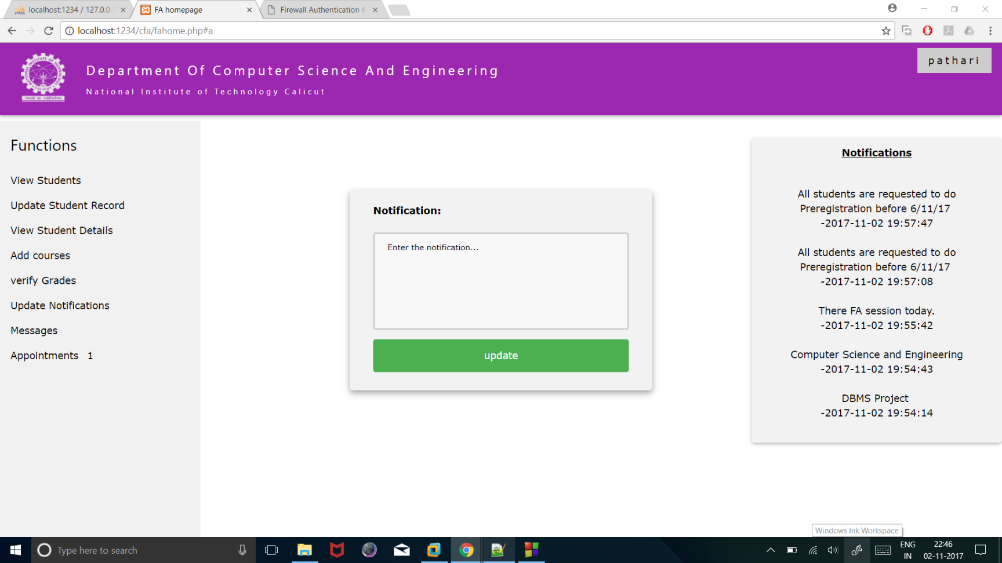
Notifications
FA can update notifications that can be viewed by FA, Student, HOD.

Slide 17
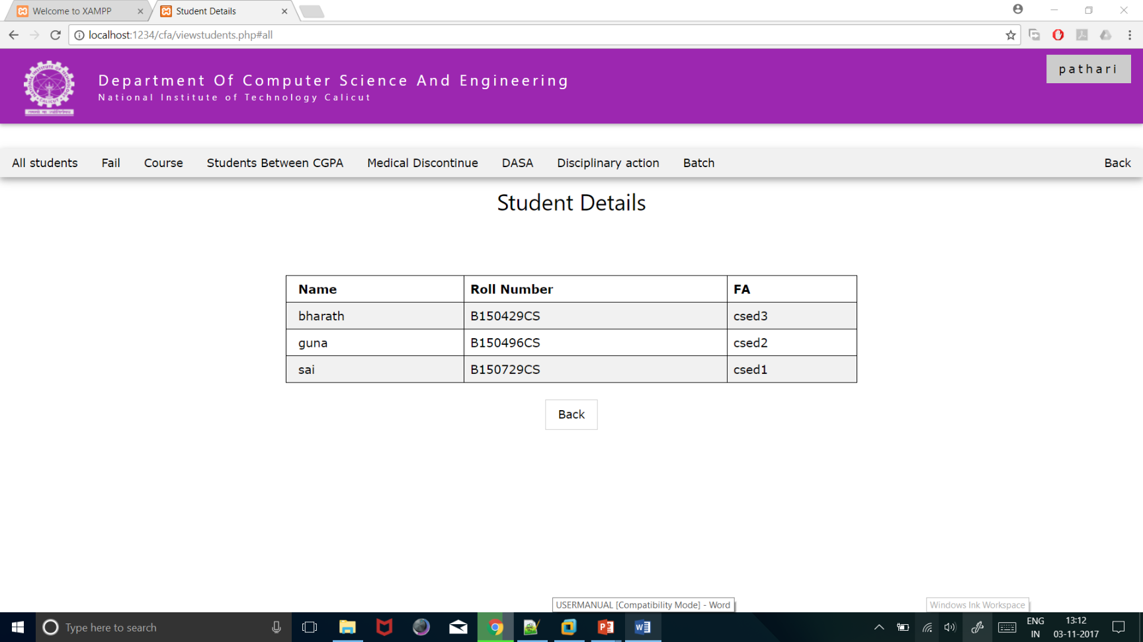
View Details
FA can view student details. He can also view specific details of the students. The view options are provided in the navigation bar

Slide 18
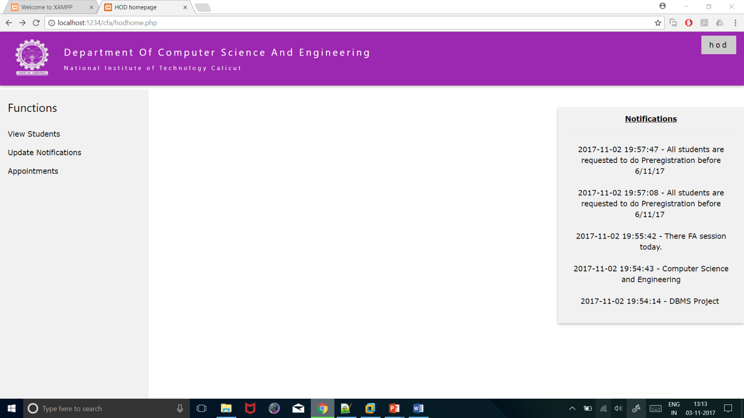
HOD Homepage
HOD homepage

Slide 19
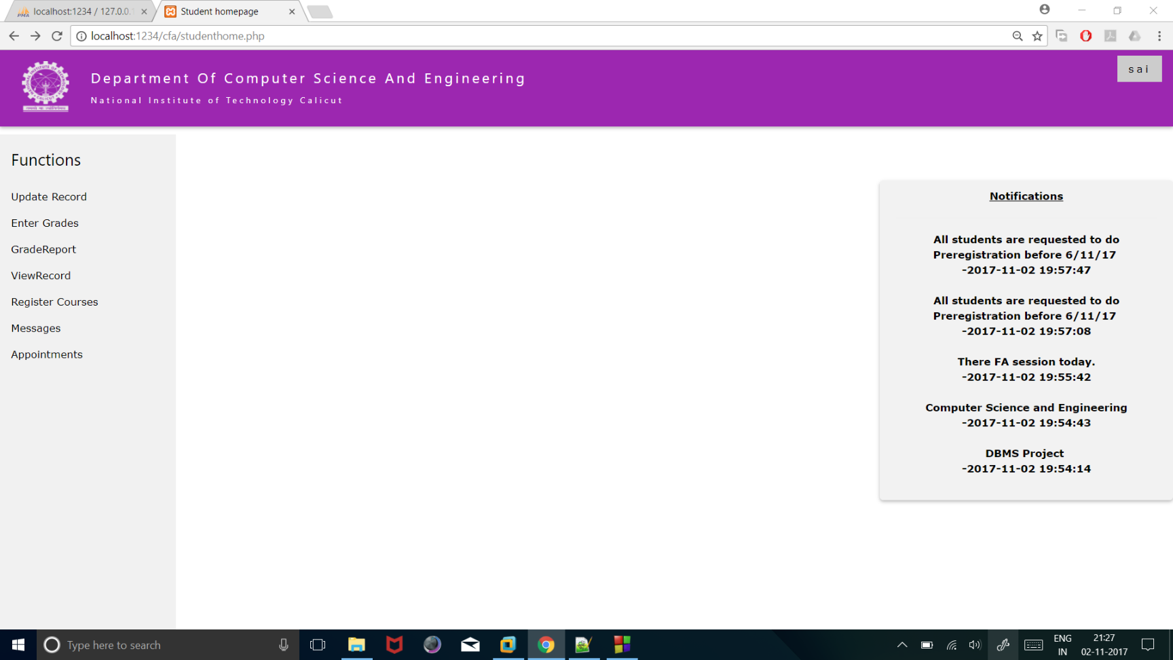
Student Homepage
Student homepage consists of functions to update profile, request appointments, update student record, update academic details,send messages, register for courses.

Slide 20
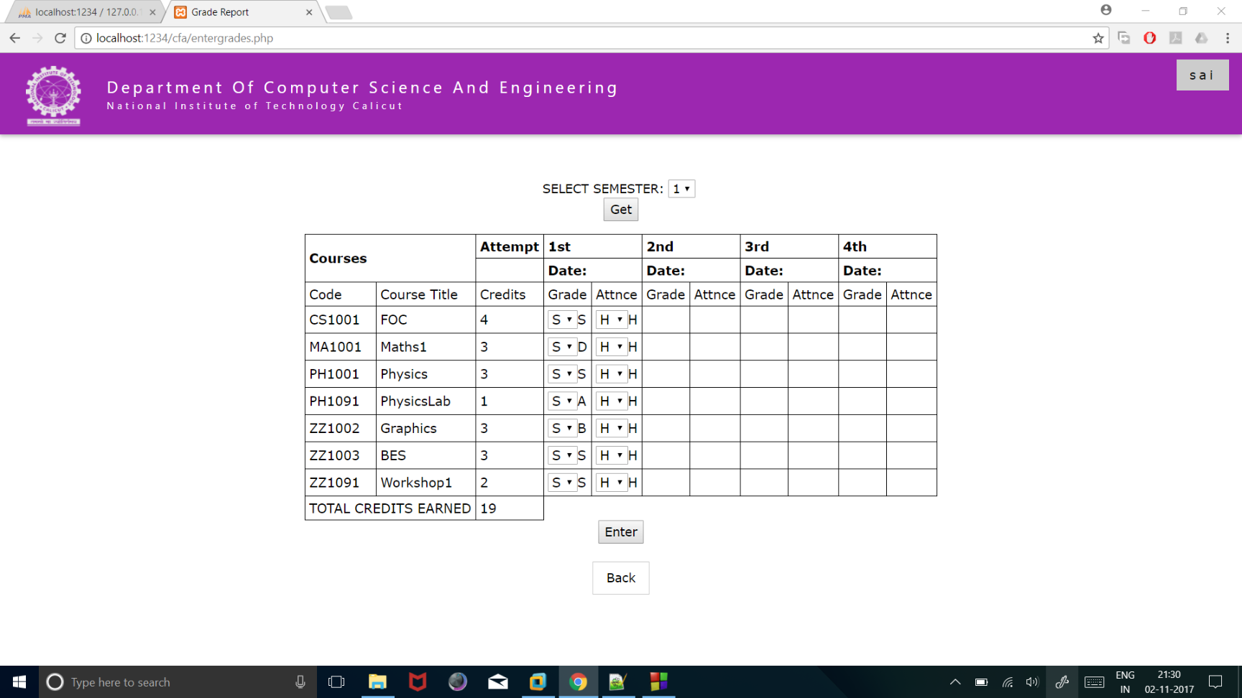
Update Academic Details
Students can update the semester details at the end of the semester

Slide 21
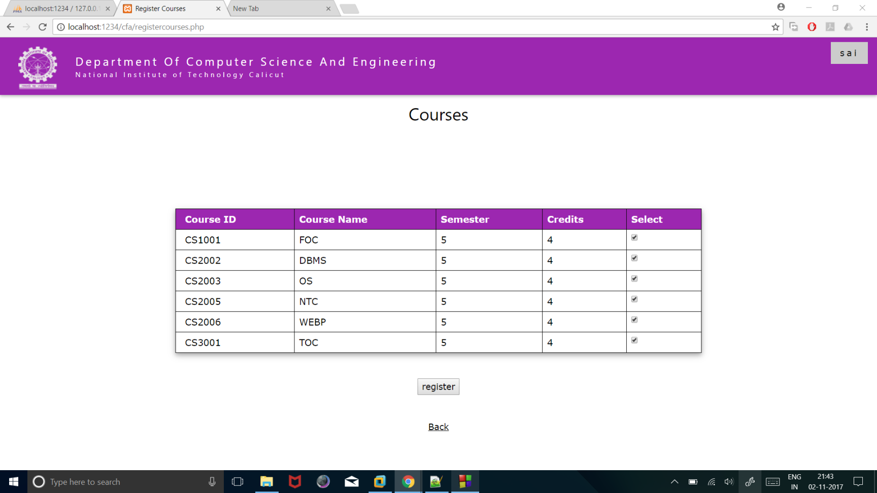
Register Courses
Students can pre register to the courses that are added by the faculty.

Slide 22
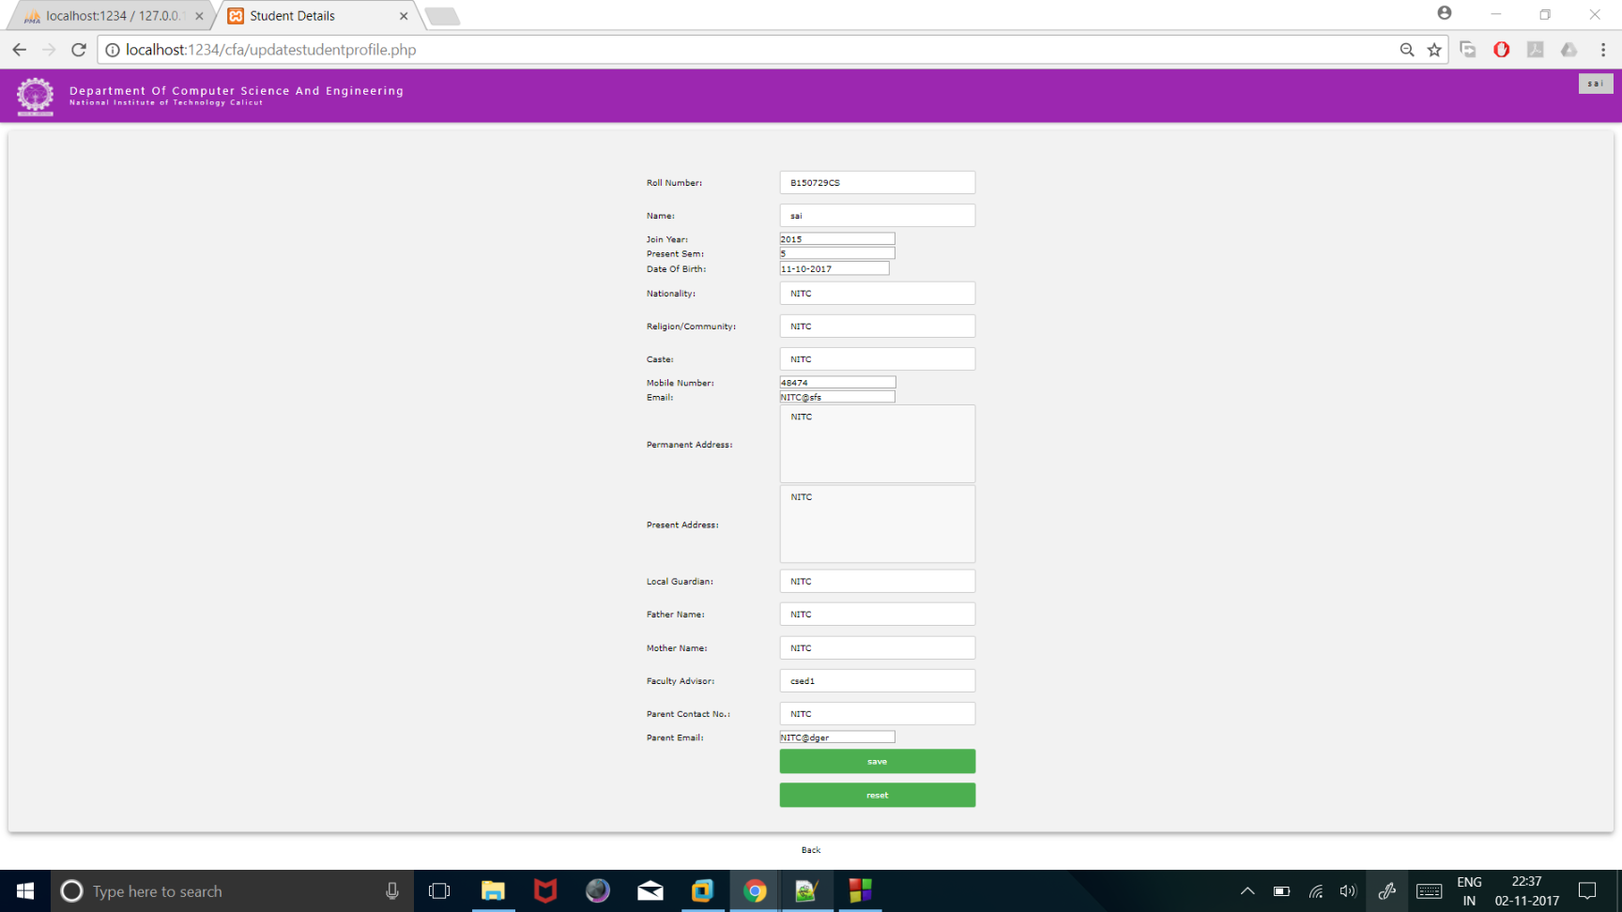
Update Student Profile
Student can update their personal information in this section.

Slide 23
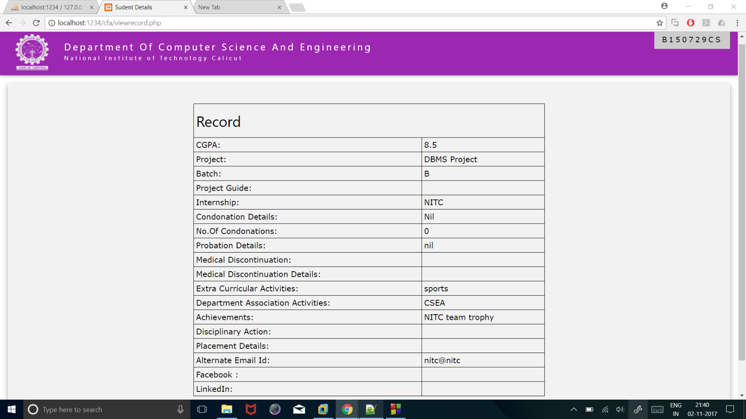
Update Student Record
Student can update few sections in the student record

Slide 24
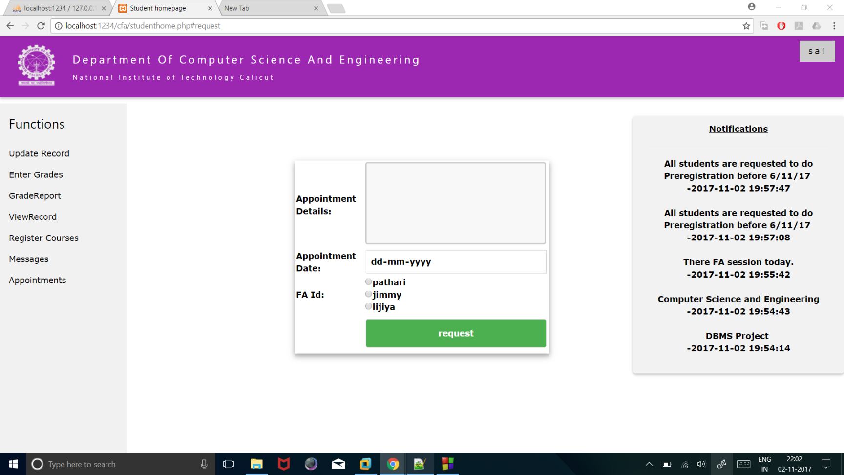
Request Appointments
Student can request an appointment with the FA on a particular day with a valid reason.

Slide 25
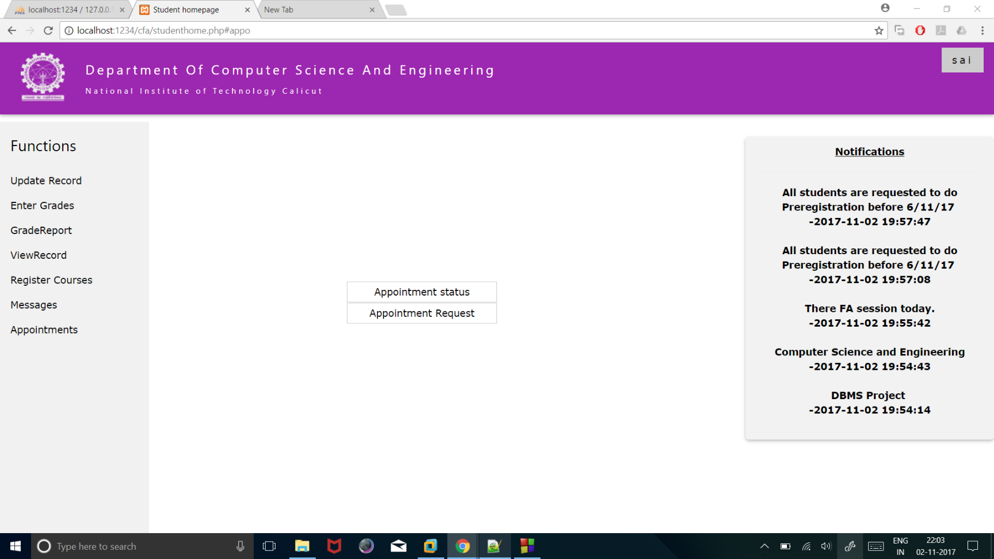
Appointment Status
Student can view the status of his appointment request. He cannot request a second appointment to the same FA while first appointment is still pending

